Slide 1
Non-Functional Requirements
Quality attributes and other NF items

Slide 2
Types of Requirements
Business Requirements
Business Rules
Vision and Scope Document
User Requirements
Quality Attributes
User Requirements Document
External
Interfaces
System Requirements
Functional Requirements
Constraints
Software Requirements Specification
Solid arrow – stored in
Dotted arrow – origin of or influence
Software Requirements, 3rd Edition

Slide 3
Types of Requirements
  Business Requirement: A high-level business objective of the organization that builds a product or of a customer who procures it
  Business Rule: A policy, guideline, standard, or regulation that defines or constrains some aspect of the business
  Constraint: A restriction that is imposed on the choices available for the design and construction of a product
  External Interface Requirement: A description of a connection between a software system and a user, another software system or a hardware device
  Functional Requirement: A description of a behavior that a system will exhibit under specific conditions
  Nonfunctional Requirement: A description of a property or characteristic that a system must exhibit or a constraint that is must respect
  Quality Attribute: A nonfunctional requirement that describes a service or performance characteristic of a product
  System Requirement: A top-level requirement for a product that contains multiple subsystems
  User Requirement: A goal or task that specific classes of users must be able to perform with a system, or a desired product attribute
Software Requirements, 3rd Edition

Slide 4
Nonfunctional Requirements
System requirements
  Associated hardware, inputs and outputs, major software components
  System architecture is not necessarily the software architecture
External interfaces
  Interfaces to devices and systems across the system boundary
  E.g, legacy systems, services, peripheral devices
Constraints – limiting factors
  E.g., technology choices, standards, business rules, laws, etc.
Quality
  Items affecting the overall ‘goodness’ of the system

Slide 5
Definition & Advice
Definition:
“A Quality Attribute is a measurable or testable property of a system that is used to indicate how well the system satisfies the needs of its stakeholders.” (SAiP p.39)
Advice:
How do you know something is an important quality attribute?
Ask yourself this question – ‘would people still use my application if we have a terrible score on this attribute?’
Some material in these slides is adapted from Software Architecture in Practice, 3rd edition by Bass, Clements and Kazman.

Slide 6
Quality Attributes – Master List
Operational categories
  Availability
  Interoperability
  Reliability
  Usability
  Performance
  Deployability
  Scalability
  Monitorability
  Mobility
  Compatibility
  Security
  Safety
Developmental categories
  Modifiability
  Variability
  Supportability
  Testability
  Maintainability
  Portability
  Localizability
  Development distributability
  Buildability

Slide 7
Descriptions
Others
Availability
Efficiency
Installability
Integrity
Interoperability
Modifiability
Portability
Reliability
Reusability
Robustness
Scalability
Verifiability
Usability
Usability requirements deal with ease of learning, ease of use, error avoidance and recovery, efficiency of interactions, and accessibility. The usability requirements specified here will help the user interface designer create the optimum user experience.
Performance
State specific performance requirements for various system operations. If different functional requirements or features have different performance requirements, it’s appropriate to specify those performance goals right with the corresponding functional requirements, rather than collecting them in this section.
Security
Specify any requirements regarding security or privacy issues that restrict access to or use of the product. These could refer to physical, data, or software security. Security requirements often originate in business rules, so identify any security or privacy policies or regulations to which the product must conform. If these are documented in a business rules repository, just refer to them.
Safety
Specify requirements that are concerned with possible loss, damage, or harm that could result from use of the product. Define any safeguards or actions that must be taken, as well as potentially dangerous actions that must be prevented. Identify any safety certifications, policies, or regulations to which the product must conform.
Wiegers, Karl. Software Requirements, 3rd Edition. Microsoft Press PTG, 2014. [Bookshelf Online].

Slide 8
Scenarios
Web application for banking
Describe a:
- Performance Attribute
- Security Attribute
- Integrity Attribute
- Availability Attribute
Control system for driverless car
Describe a:
- Performance Attribute
- Security Attribute
- Safety Attribute
- Reliability Attribute
What would be a good example of a Portability Attribute?
Notes:
Portability: Mobile app (iOS/ Android)

Slide 9
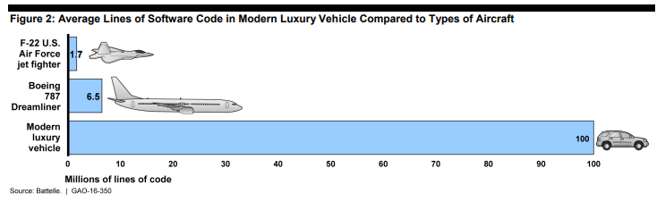
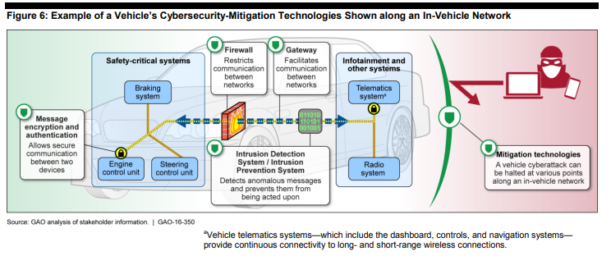
Driverless Vehicle Security
https://www.gao.gov/assets/680/676064.pdf

Slide 10
Requirements Assumptions and Dependencies
Business and technology
Assumptions – stuff you expect to happen (versus known facts)
  Project impacts if incorrect or they change
Dependencies – stuff that is needed from external sources
Examples of “stuff” – schedules, budget, contracts, intellectual property, people resources, equipment resources, licenses, standards, regulations, open source software, external APIs, cloud services, development tools, …

Slide 11
Examples
If you are building a desktop application
- Connects to online brokerage system
List some assumptions
List some dependencies
Notes:
Assumption: Have license to connect to brokerage system
Dependency: API documentation is available

